Slide 1

Module 4
Model Building
Notes:
Guidelines
Use section headers to chunk content in your presentation.
Use the same style of section header throughout your presentation.
Keep your title to no more than 2 lines.

Slide 2
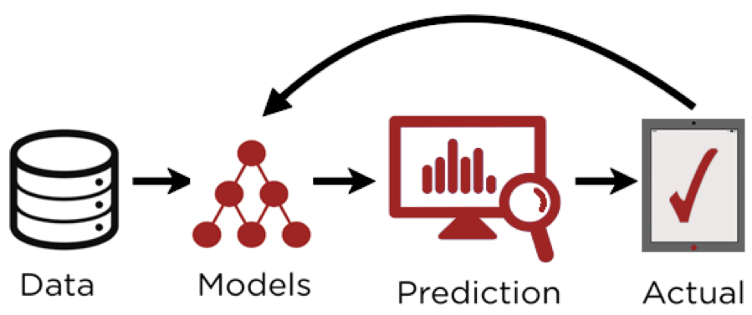
Predictive Modeling
Notes:
Guidelines
Use a title slide at the beginning of your presentation. There are 9 variations of title slides to choose from.
If you will have a series of slideshows, we recommend using the same style of title slide for each presentation.
Keep your title to no more than 2 lines.
Do not change the font style or font size of the title or subtitle.

Slide 3
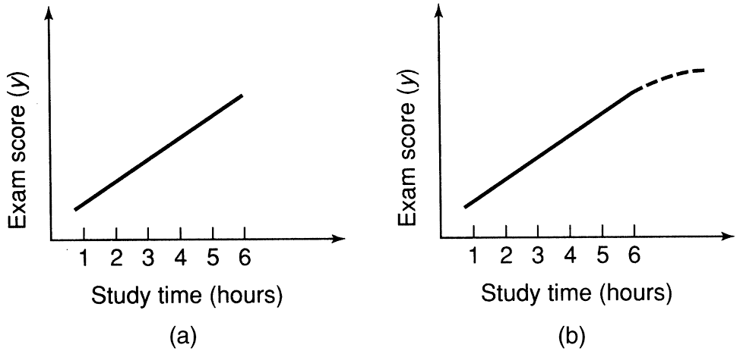
Extrapolation
Estimating or predicting beyond the range of the original data

Slide 4
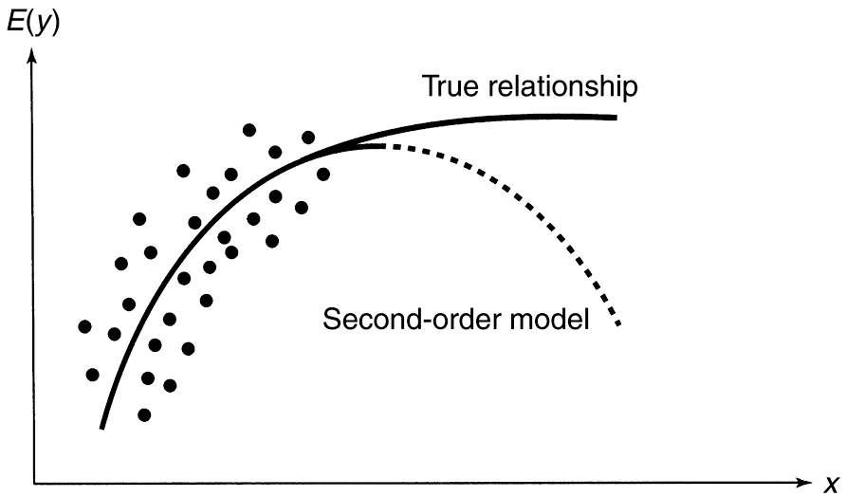
Extrapolation With Higher-Order Models
Estimating or predicting beyond the range of the original data

Slide 5
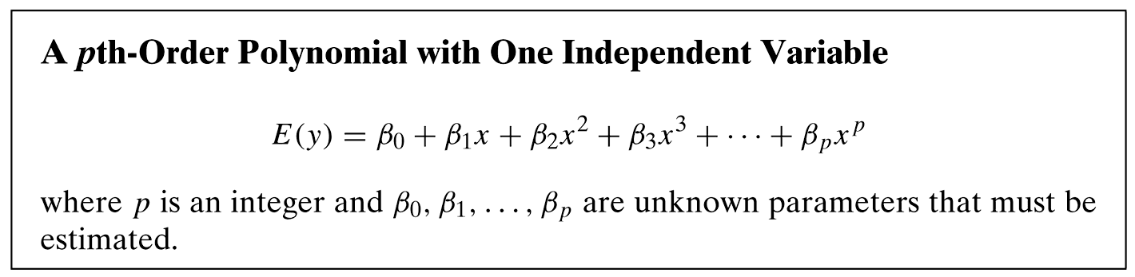
Extrapolation With Higher-Order Models
Estimating or predicting beyond the range of the original data

Slide 6
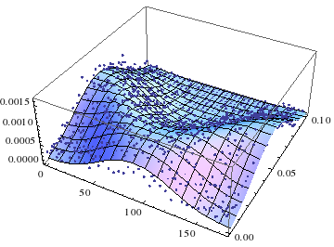
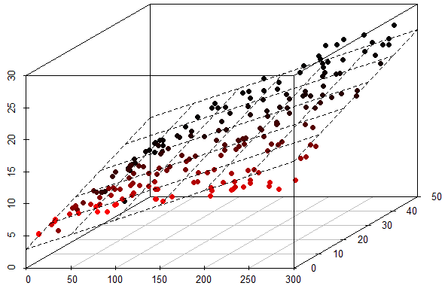
Extrapolation With Higher-Order Models

Slide 7
Example: Quadratic Model

Slide 8
Example: Quadratic Model Best Fit

Slide 9
Example: Quadratic Model Overfit

Slide 10
Overfitting vs Underfitting
Overfitting: is a modeling error that occurs when a function is too closely fit to a limited set of data points
Underfitting: Is a modeling error that occurs when a function is not sufficient to fit the training samples

Slide 11
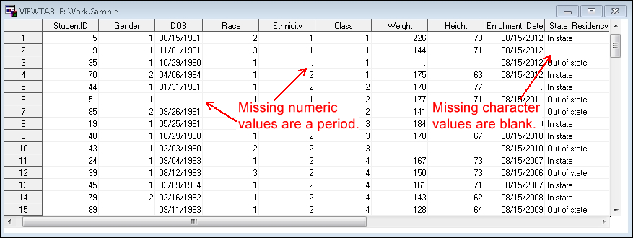
Missing Data
Observations with missing data are ignored
We need to check for missing values

Slide 12

Missing Data
We need to check for missing values
The R code below shows the number of missing per variable

Slide 13
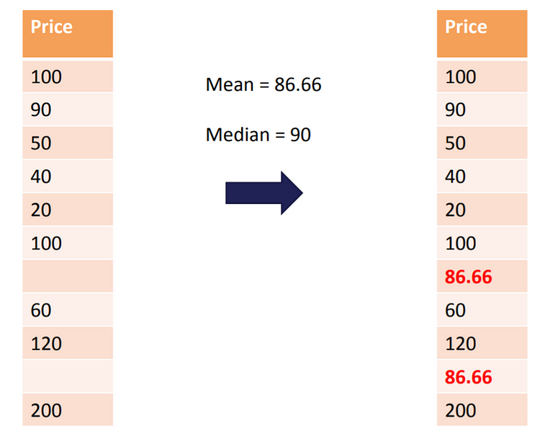
Imputation for Numeric Variables
Imputation is the process of replacing missing with substituted values.
Mean and median imputation are commonly used

Slide 14
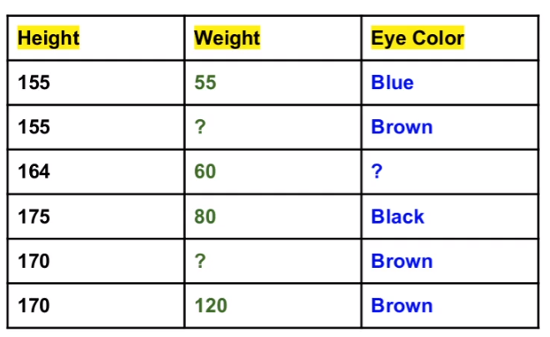
Imputation for Categorical Variables
Creating new level, say “unknown” is common.

Slide 15
Train/Test Split to Avoid Overfitting
Using NEW data to check model performance

Slide 16
Train/Test Split to Avoid Overfitting
Train/Test split is a model validation process that allows you to simulate how your model would perform with new data

Slide 17
Checking Metrics on Test Data
We have to calculate metrics on the test data
Most used metrics:
R² Validation – can be compared to R²
ASE Validation – can be compared to MSE
RASE Validation – can be compared to RMSE

Slide 18
Checking Metrics on Test Data
We have to calculate metrics on the test data
Most used metrics:
R² Validation – can be compared to R²
ASE Validation – can be compared to MSE
RASE Validation – can be compared to RMSE

Slide 19

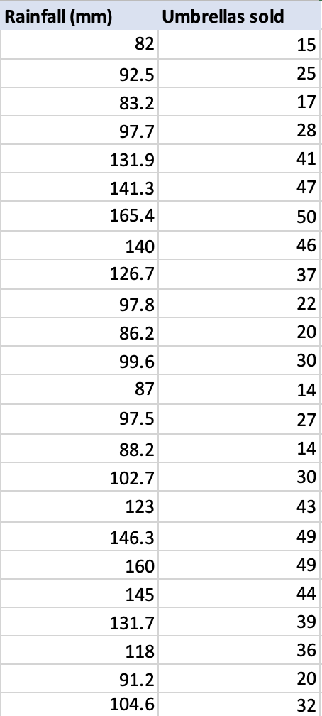
Example: Umbrellas

Slide 20
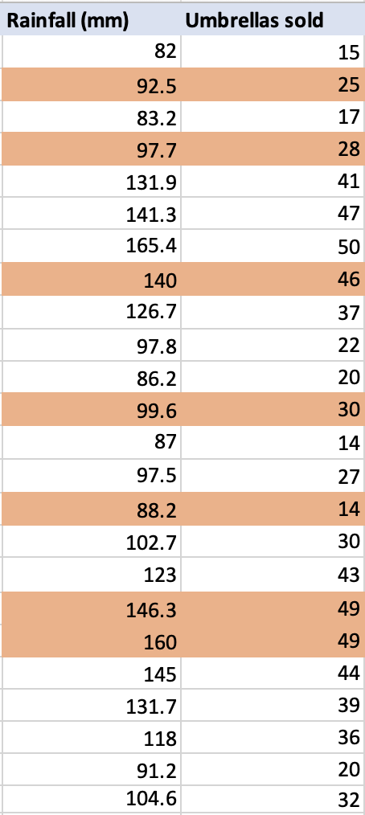
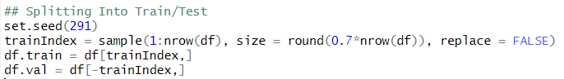
Example: Umbrellas
70%
30%

Slide 21
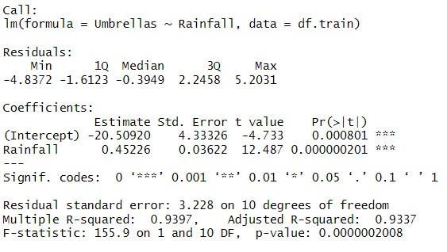
Example: Umbrellas Model 1

Slide 22
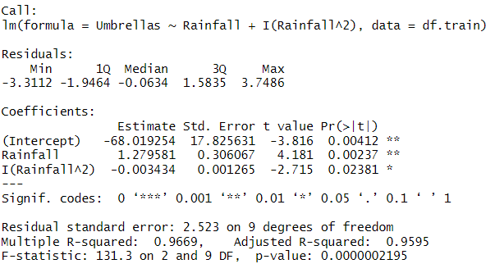
Example: Umbrellas Model 2

Slide 23
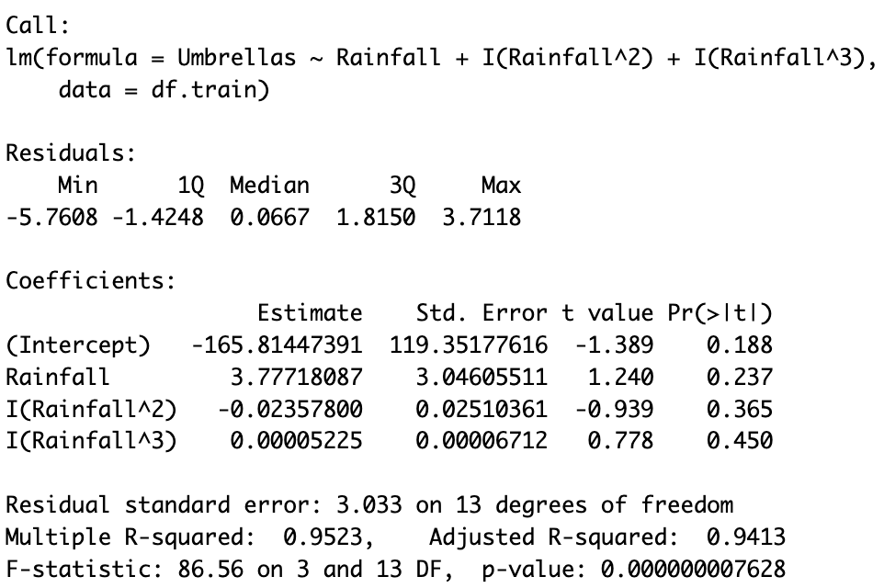
Example: Umbrellas Model 3

Slide 24
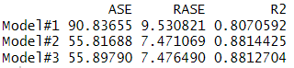
Example: Calculating Metrics on Test
Model 1
Model 2
Model 3

